Slide 1
Which Media type had the most sales?
Proportion_of_sales
5%
7%
MPEG audio file
Protected AAC audio file
Protected MPEG-4 video file
Purchased AAC audio file
AAC audio file
88%
We note a significant superiority of
MPEG audio file .
<visualization>

Slide 2




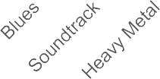
Which genre had the most sales?
Genre with Sales
Here we are calculating the number of selling tracks.
We get that Rock in the top with 160 track
180
160
140
120
100
80
60
40
20
0
160
 |  | 81
 |  |  |  | 56 56
 |  |  |  |  |  |  |  | 19 ⁸ 6 5 4 4
Num_of_sales
<visualization>
Genre

Slide 3

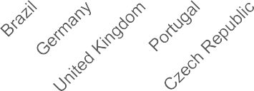

Which Countries had the most sales?
TOP_Countries_sales
91
We calculate here the amount of sales for every country
USA at the top with 91
100
90
80
70
60
50
40
30
20
10
0
num_of_sales
56
35 35
28
<visualization>
21
14 14 13
7
Country

Slide 4

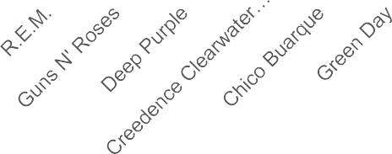
Who are the top 10 best selling artists?
Most_listened_artists
WE calculate the selling amount for each artist
Iron Maiden at the top with 34
40
35
30
25
20
15
10
5
0
34
Num_of_sales
22
16
23
12 12 12
11 11
10
<visualization>
Name

